Slide 1
Chapter 3
The Greedy Method
4 -<number>

Slide 2
The greedy method
Suppose that a problem can be solved by a sequence of decisions. The greedy method has that each decision is locally optimal. These locally optimal solutions will finally add up to a globally optimal solution.
Only a few optimization problems can be solved by the greedy method.
4 -<number>

Slide 3
An simple example
Problem: Pick k numbers out of n numbers such that the sum of these k numbers is the largest.
Algorithm:
    FOR i = 1 to k
    pick out the largest number and
    delete this number from the input.
    ENDFOR
4 -<number>

Slide 4
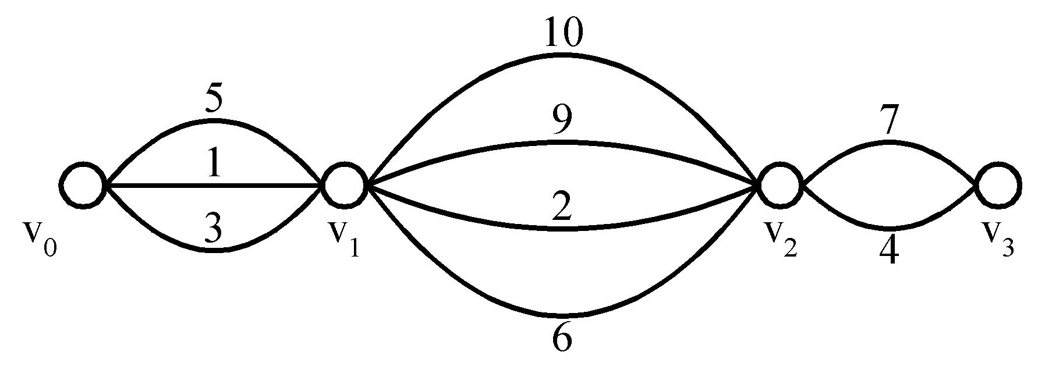
Shortest paths on a special graph
Problem: Find a shortest path from v₀ to v₃.
The greedy method can solve this problem.
The shortest path: 1 + 2 + 4 = 7.
4 -<number>

Slide 5
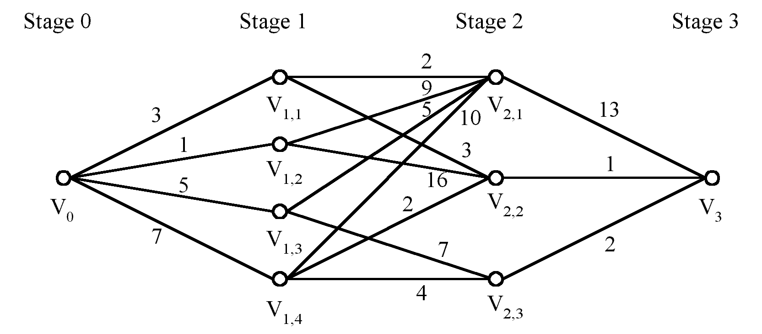
Shortest paths on a multi-stage graph
Problem: Find a shortest path from v₀ to v₃ in the multi-stage graph.
Greedy method: v₀v_{1,2}v_{2,1}v₃ = 23
Optimal: v₀v_{1,1}v_{2,2}v₃ = 7
The greedy method does not work.
4 -<number>

Slide 6

Solution of the above problem
d_{min}(i,j): minimum distance between i and j.
This problem can be solved by the dynamic programming method.
4 -<number>

Slide 7
Minimum spanning trees (MST)
It may be defined on Euclidean space points or on a graph.
G = (V, E): weighted connected undirected graph
Spanning tree : S = (V, T), T ⊆ E, undirected tree
Minimum spanning tree(MST) : a spanning tree with the smallest total weight.
4 -<number>

Slide 8
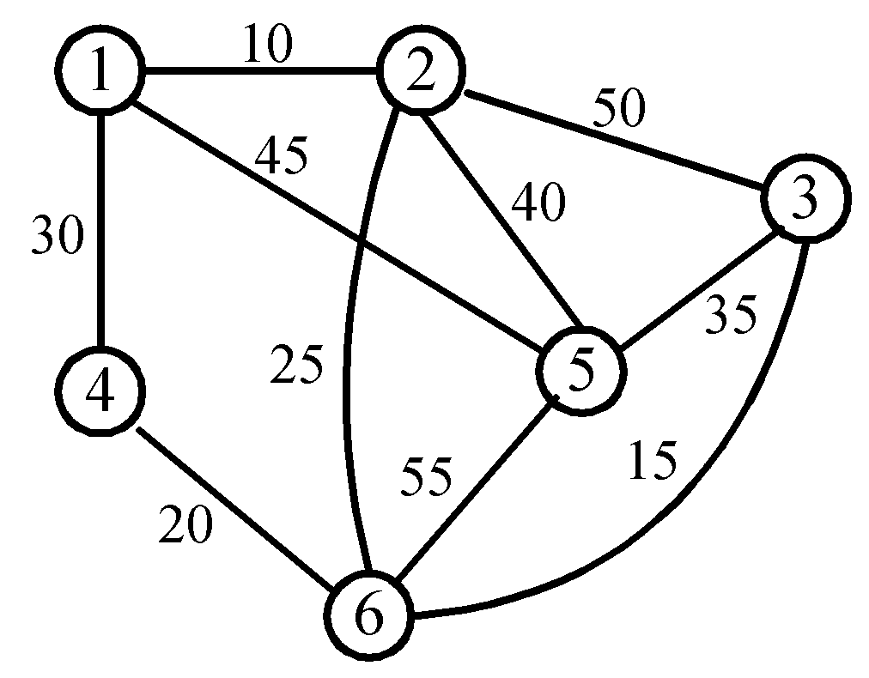
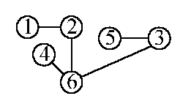
An example of MST
A graph and one of its minimum costs spanning tree
4 -<number>

Slide 9
Kruskal’s algorithm for finding MST
Step 1: Sort all edges into nondecreasing order.
Step 2: Add the next smallest weight edge to the forest if it will not cause a cycle.
Step 3: Stop if n-1 edges. Otherwise, go to Step2.
4 -<number>

Slide 10
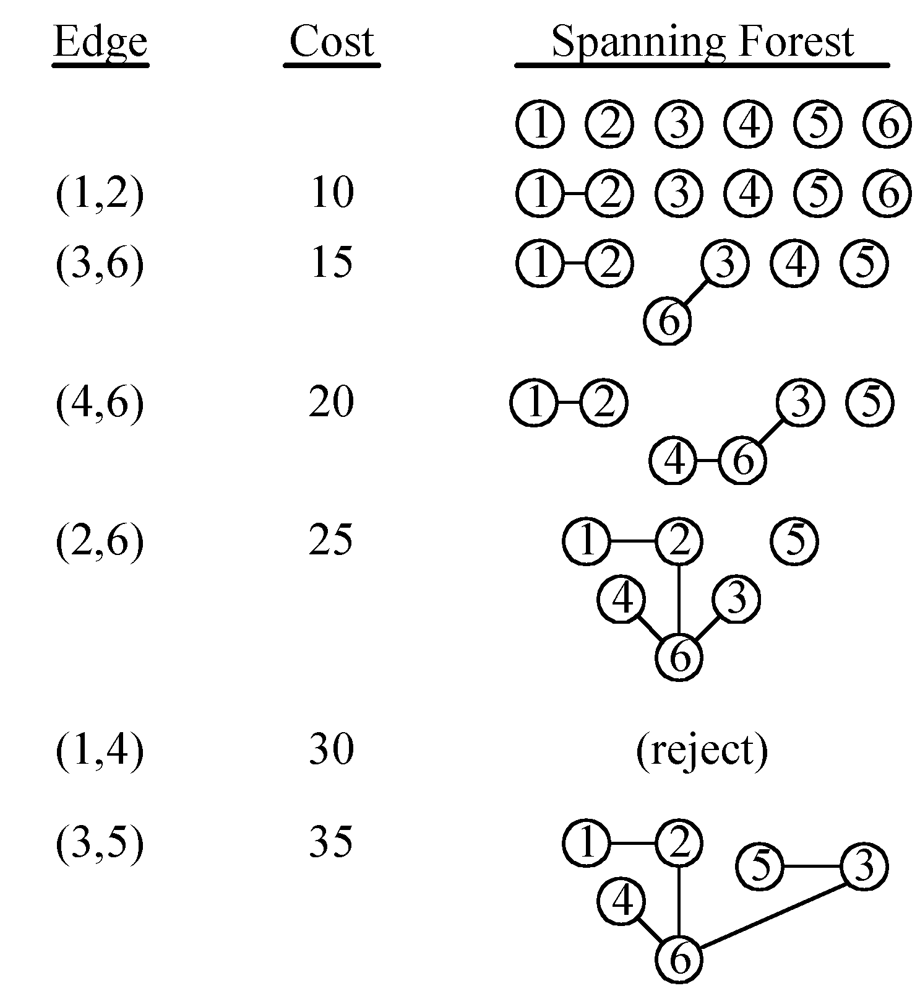
An example of Kruskal’s algorithm
4 -<number>

Slide 11
The details for constructing MST
How do we check if a cycle is formed when a new edge is added?
  By the SET and UNION method.
A tree in the forest is used to represent a SET.
If (u, v) ∈ E and u, v are in the same set, then the addition of (u, v) will form a cycle.
If (u, v) ∈ E and u∈S₁ , v∈S₂ , then perform UNION of S₁ and S₂ .
4 -<number>

Slide 12

Time complexity
Time complexity: O(|E| log|E|)
  Step 1: O(|E| log|E|)
  Step 2 & Step 3:
  Where α is the inverse of Ackermann’s function.
4 -<number>

Slide 13

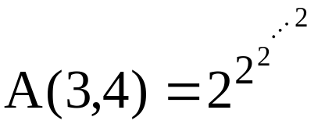

Ackermann’s function
⇒ A(p, q+1) > A(p, q), A(p+1, q) > A(p, q)
65536 two’s
4 -<number>

Slide 14
Inverse of Ackermann’s function
α(m, n) = min{Z≥1|A(Z,4⎡m/n⎤) > log₂n}
Practically, A(3,4) > log₂n
⇒α(m, n) ≤ 3
⇒α(m, n) is almost a constant.
4 -<number>

Slide 15
Prim’s algorithm for finding MST
Step 1: x ∈ V, Let A = {x}, B = V - {x}.
Step 2: Select (u, v) ∈ E, u ∈ A, v ∈ B such that (u, v) has the smallest weight between A and B.
Step 3: Put (u, v) in the tree. A = A ∪ {v}, B = B - {v}
Step 4: If B = ∅, stop; otherwise, go to Step 2.
Time complexity : O(n²), n = |V|.
(see the example on the next page)
4 -<number>

Slide 16
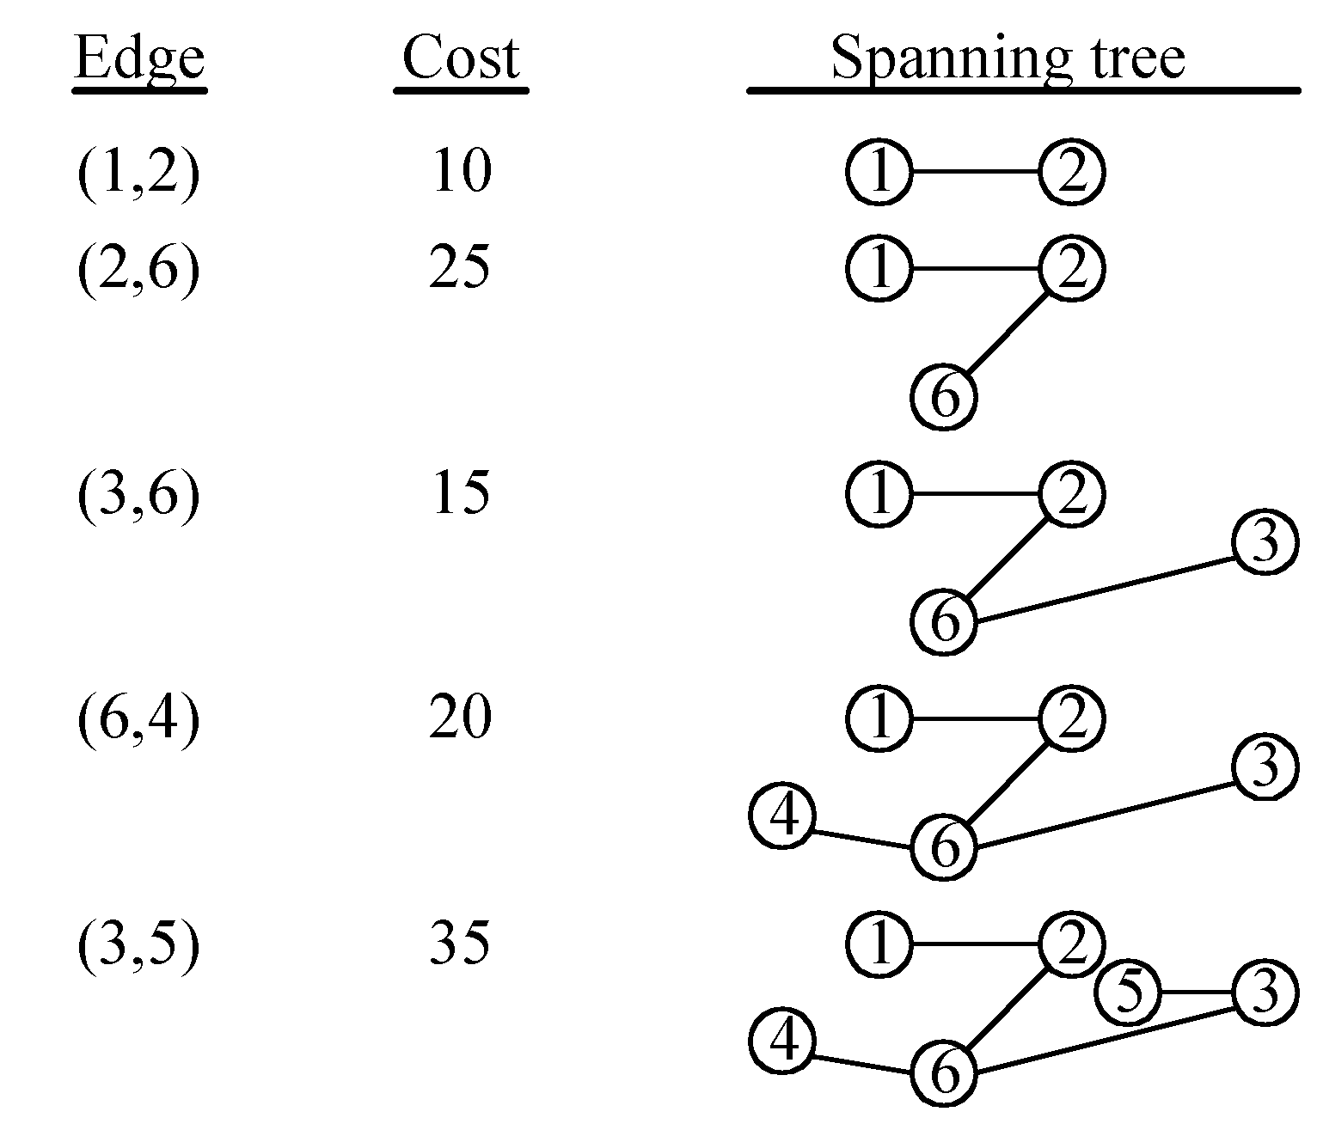
An example for Prim’s algorithm
4 -<number>

Slide 17
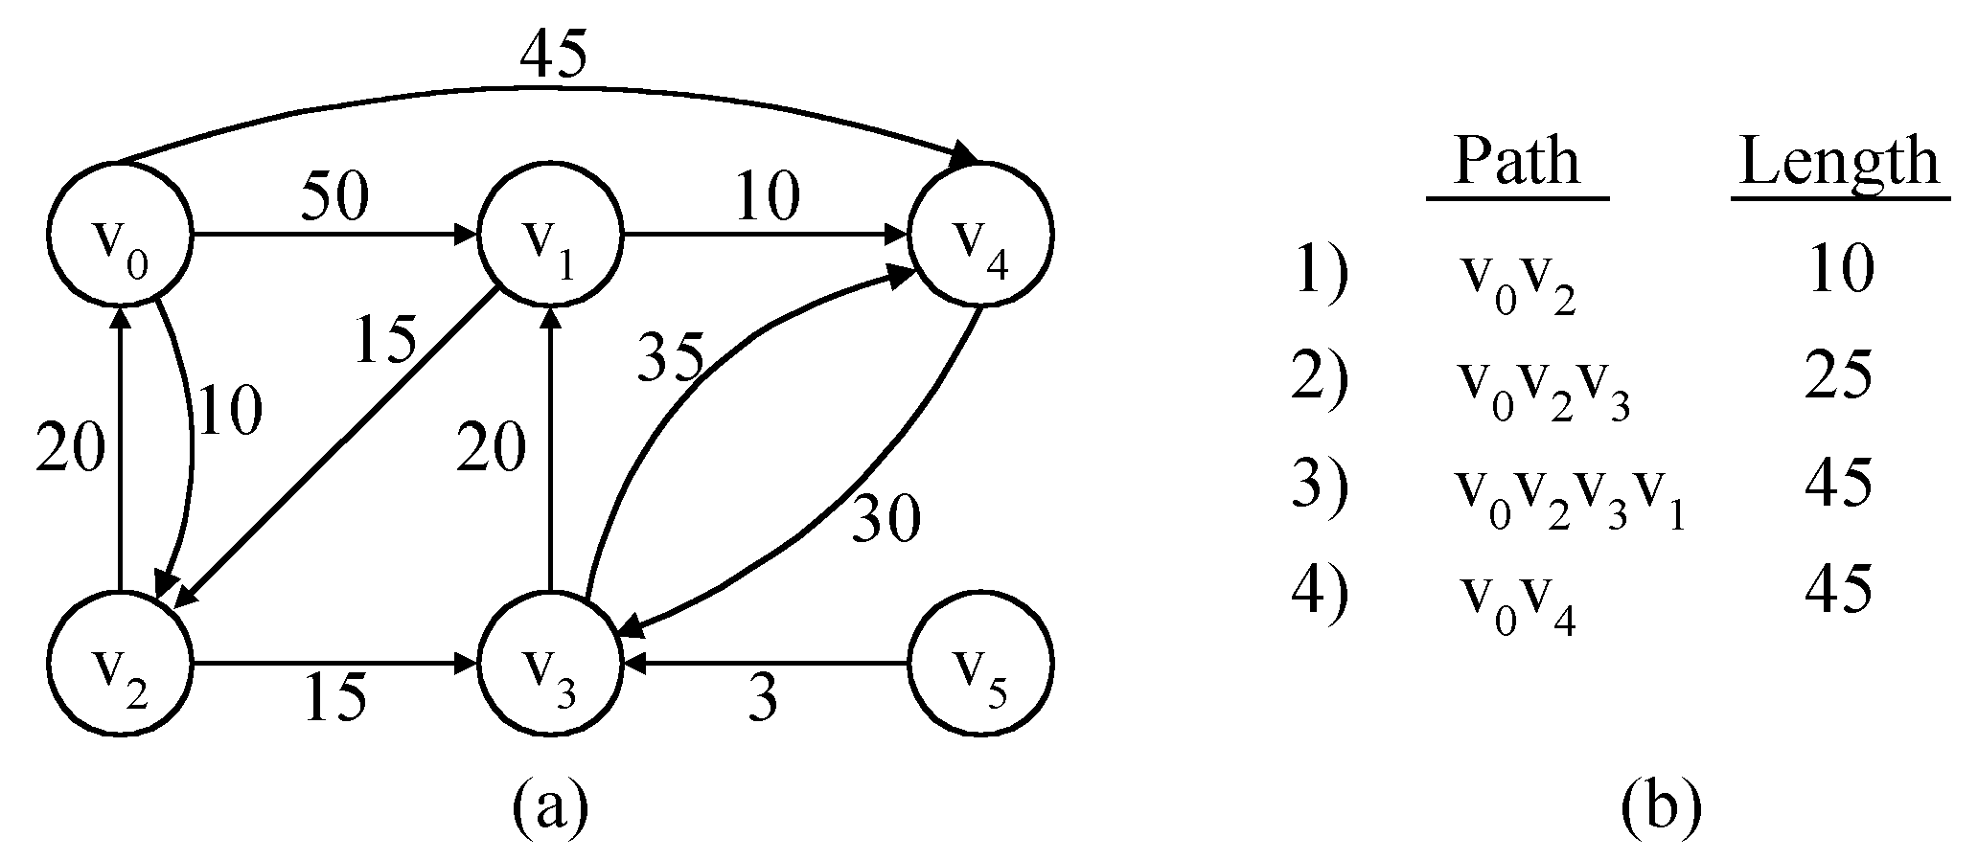
The single-source shortest path problem
shortest paths from v₀ to all destinations
4 -<number>

Slide 18
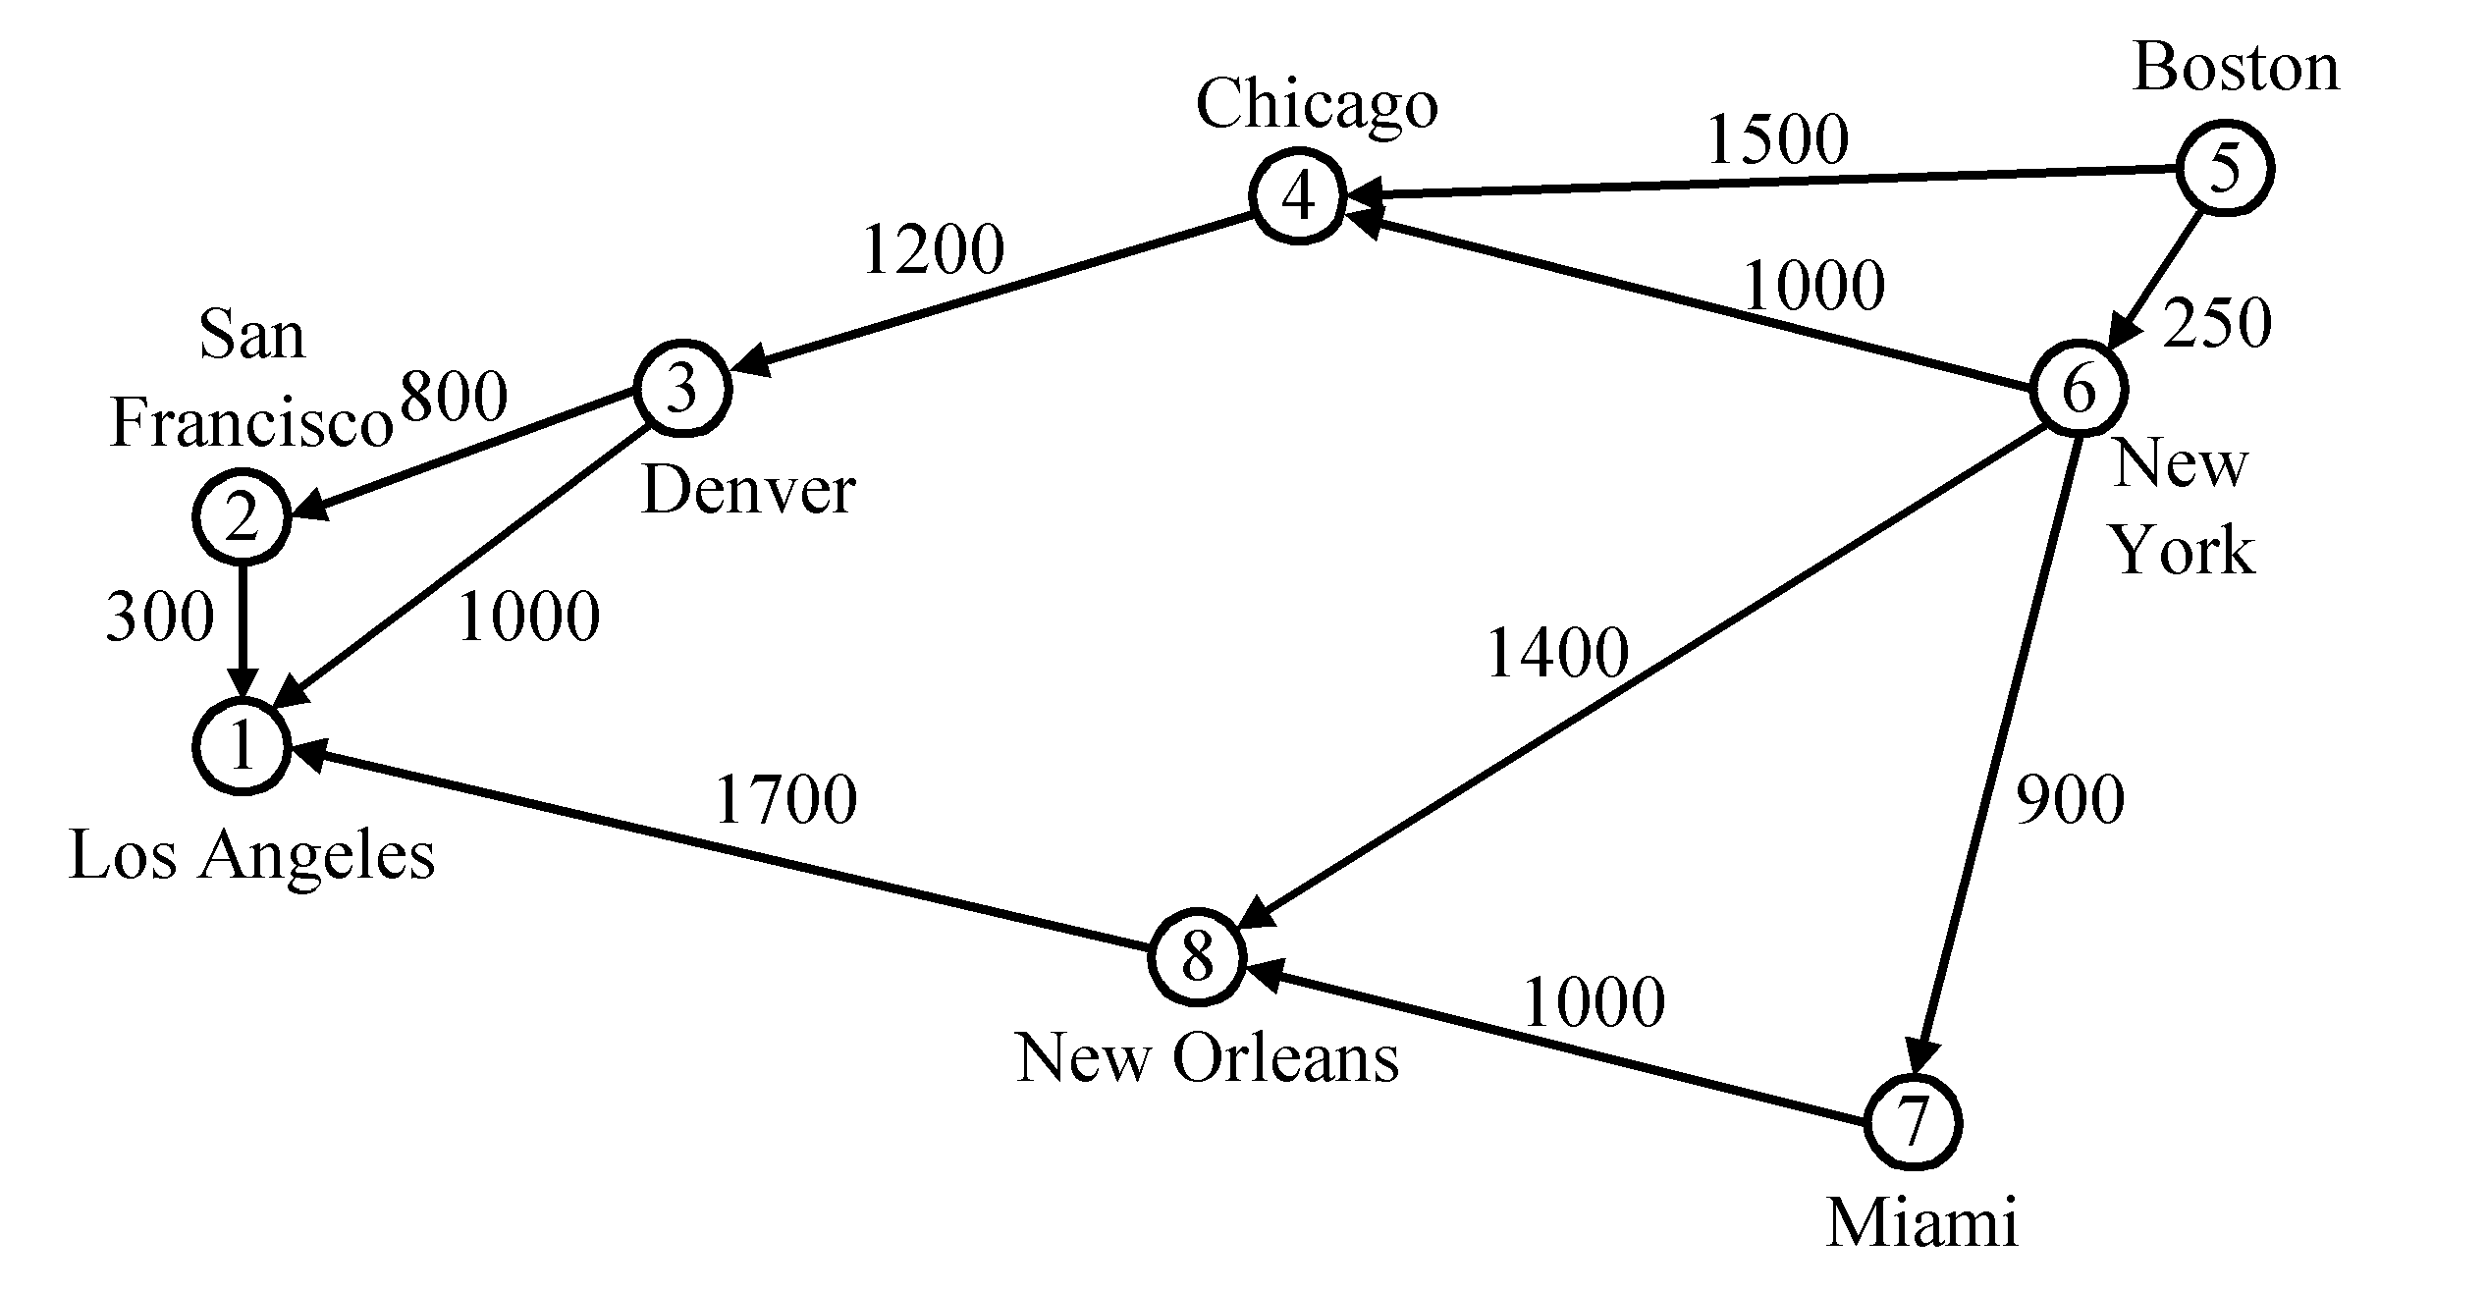
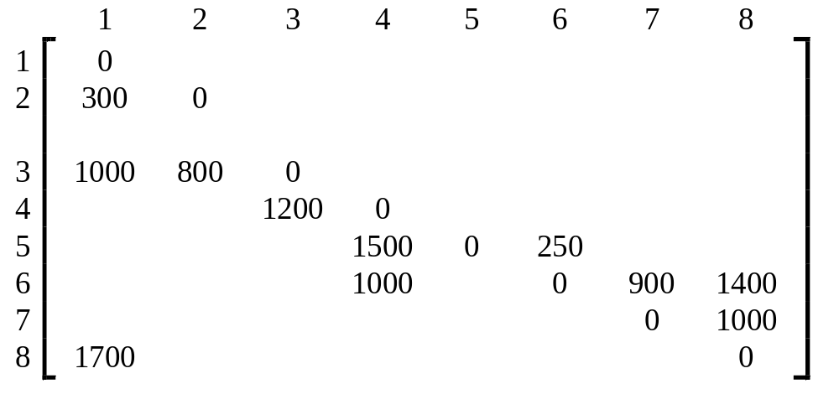
Dijkstra’s algorithm
Cost adjacency matrix. All entries not shown are +∞.
4 -<number>

Slide 19
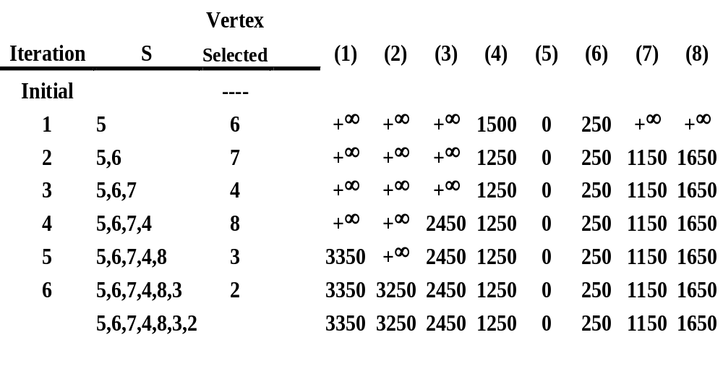
Time complexity : O(n²)
4 -<number>

Slide 20
The longest path problem
Can we use Dijkstra’s algorithm to find the longest path from a starting vertex to an ending vertex in an acyclic directed graph?
There are 3 possible ways to apply Dijkstra’s algorithm:
  Directly use “max” operations instead of “min” operations.
  Convert all positive weights to be negative. Then find the shortest path.
  Give a very large positive number M. If the weight of an edge is w, now M-w is used to replace w. Then find the shortest path.
All these 3 possible ways would not work!
4 -<number>

Slide 21
Activity On Edge (AOE) Networks
Tasks (activities) : a0, a1,…
Events : v0,v1,…
V1
V6
a0 = 6
a3 = 1
a6 = 9
a9 = 2
start
V0
V4
V8
finish
a1 = 4
a4 = 1
a7 = 7
a10 = 4
V2
V7
Some definition:
  Predecessor
  Successor
  Immediate predecessor
  Immediate successor
a2 = 5
a8 = 4
a5 = 2
V3
V5
4 -<number>

Slide 22
critical path
A critical path is a path that has the longest length. (v0, v1, v4, v7, v8)
V1
V6
a0 = 6
a3 = 1
a6 = 9
a9 = 2
start
V0
V4
V8
finish
a1 = 4
a4 = 1
a7 = 7
a10 = 4
V2
V7
a2 = 5
a8 = 4
6 + 1 + 7 + 4 = 18 (Max)
a5 = 2
V3
V5
4 -<number>

Slide 23
The earliest time
The earliest time of an activity, a_{i}, can occur is the length of the longest path from the start vertex v₀ to a_{i}’s start vertex.
（Ex: the earliest time of activity a₇ can occur is 7.）
We denote this time as early(i) for activity a_{i}.
∴ early(6) = early(7) = 7.
V1
V6
a0 = 6
a3 = 1
a6 = 9
a9 = 2
0/?
6/?
7/?
16/?
start
V0
V4
V8
finish
a1 = 4
4/?
7/?
14/?
18
0/?
a4 = 1
a7 = 7
a10 = 4
V2
V7
0/?
a2 = 5
a8 = 4
7/?
a5 = 2
V3
V5
4 -<number>
5/?

Slide 24
The latest time
The latest time, late(i), of activity, a_{i}, is defined to be the latest time the activity may start without increasing the project duration.
Ex: early(5) = 5 & late(5) = 8; early(7) = 7 & late(7) = 7
V1
V6
a0 = 6
a3 = 1
a6 = 9
a9 = 2
0/0
6/6
7/7
16/16
start
V0
V4
V8
finish
a1 = 4
4/5
7/7
14/14
0/1
a4 = 1
a7 = 7
a10 = 4
V2
V7
0/3
a2 = 5
a8 = 4
7/10
late(5) = 18 – 4 – 4 - 2 = 8
late(7) = 18 – 4 – 7 = 7
a5 = 2
V3
V5
4 -<number>
5/8

Slide 25
Critical activity
A critical activity is an activity for which early(i) = late(i).
The difference between late(i) and early(i) is a measure of how critical an activity is.
Calculation
of
Earliest Times
Finding
Critical path(s)
To solve
AOE Problem
Calculation
of
Latest Times
4 -<number>

Slide 26
Calculation of Earliest Times
Let activity a_{i} is represented by edge (u, v).
  early (i) = earliest [u]
  late (i) = latest [v] – duration of activity a_{i}
We compute the times in two stages:
a forward stage and a backward stage.
The forward stage:
  Step 1: earliest [0] = 0
  Step 2: earliest [j] = max {earliest [i] + duration of (i, j)}
  i is in P(j)
  P(j) is the set of immediate predecessors of j.
4 -<number>

Slide 27
Calculation of Latest Times
The backward stage:
  Step 1: latest[n-1] = earliest[n-1]
  Step 2: latest [j] = min {latest [i] - duration of (j, i)}
  i is in S(j)
  S(j) is the set of vertices adjacent from vertex j.
  latest[8] = earliest[8] = 18
  latest[6] = min{earliest[8] - 2} = 16
  latest[7] = min{earliest[8] - 4} = 14
  latest[4] = min{earliest[6] – 9; earliest[7] – 7} = 7
  latest[1] = min{earliest[4] - 1} = 6
  latest[2] = min{earliest[4] - 1} = 6
  latest[5] = min{earliest[7] - 4} = 10
  latest[3] = min{earliest[5] - 2} = 8
  latest[0] = min{earliest[1] – 6; earliest[2] – 4; earliest[3] – 5} = 0
4 -<number>

Slide 28
Graph with non-critical activities deleted
V1
V6
Activity | Early | Late | L - E | Critical
a₀ | 0 | 0 | 0 | Yes
a₁ | 0 | 2 | 2 | No
a₂ | 0 | 3 | 3 | No
a₃ | 6 | 6 | 0 | Yes
a₄ | 4 | 6 | 2 | No
a₅ | 5 | 8 | 3 | No
a₆ | 7 | 7 | 0 | Yes
a₇ | 7 | 7 | 0 | Yes
a₈ | 7 | 10 | 3 | No
a₉ | 16 | 16 | 0 | Yes
a₁₀ | 14 | 14 | 0 | Yes
a0
a3
a6
a9
V0
V4
V8
a1
start
V2
V7
finish
a4
a7
a10
a2
V3
V5
a8
a5
a6
V6
a0
a9
V1
a3
start
V0
V4
V8
finish
a7
V7
a10
4 -<number>

Slide 29
CPM for the longest path problem
The longest path(critical path) problem can be solved by the critical path method(CPM) :
Step 1:Find a topological ordering.
Step 2: Find the critical path.
(see [Horiwitz 1998].)
4 -<number>

Slide 30
The 2-way merging problem
# of comparisons required for the linear 2-way merge algorithm is m₁+ m₂ -1 where m₁ and m₂ are the lengths of the two sorted lists respectively.
The problem: There are n sorted lists, each of length m_{i}. What is the optimal sequence of merging process to merge these n lists into one sorted list ?
4 -<number>

Slide 31
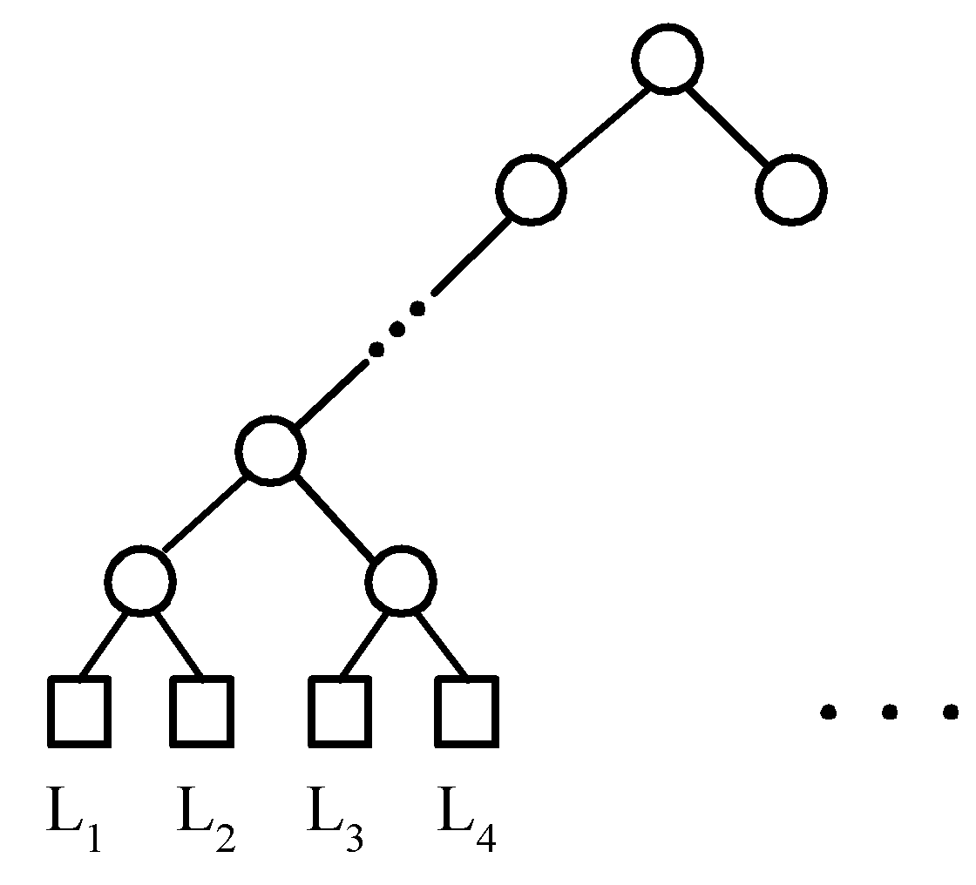
Extended binary trees
Extended Binary Tree Representing a 2-way Merge
4 -<number>

Slide 32
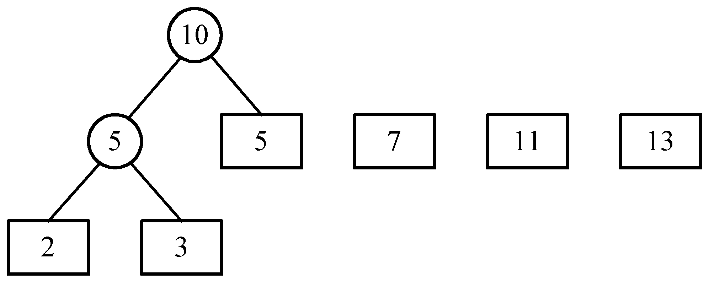
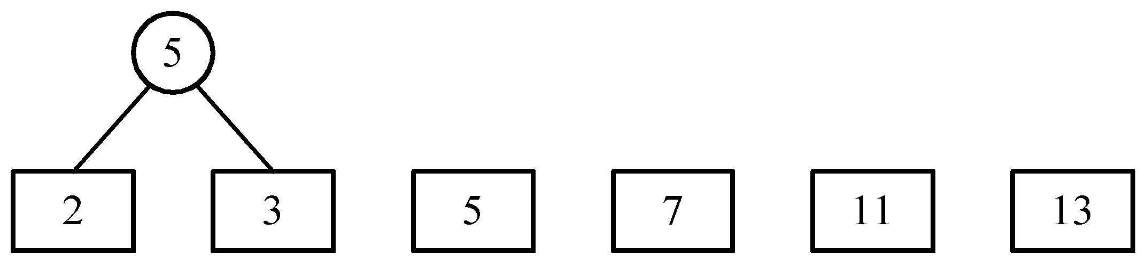
An example of 2-way merging
Example: 6 sorted lists with lengths 2, 3, 5, 7, 11 and 13.
4 -<number>

Slide 33
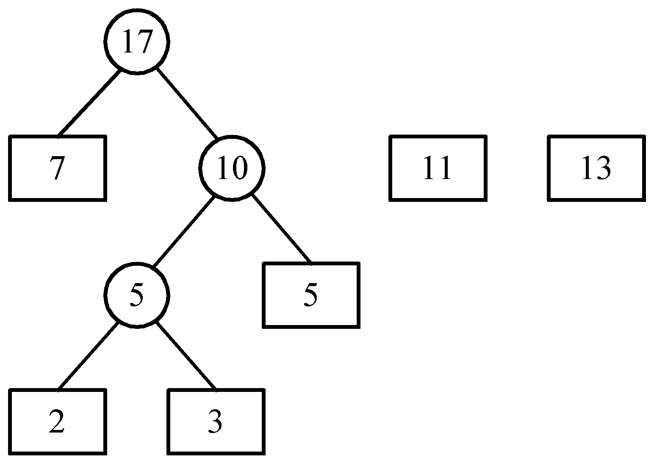
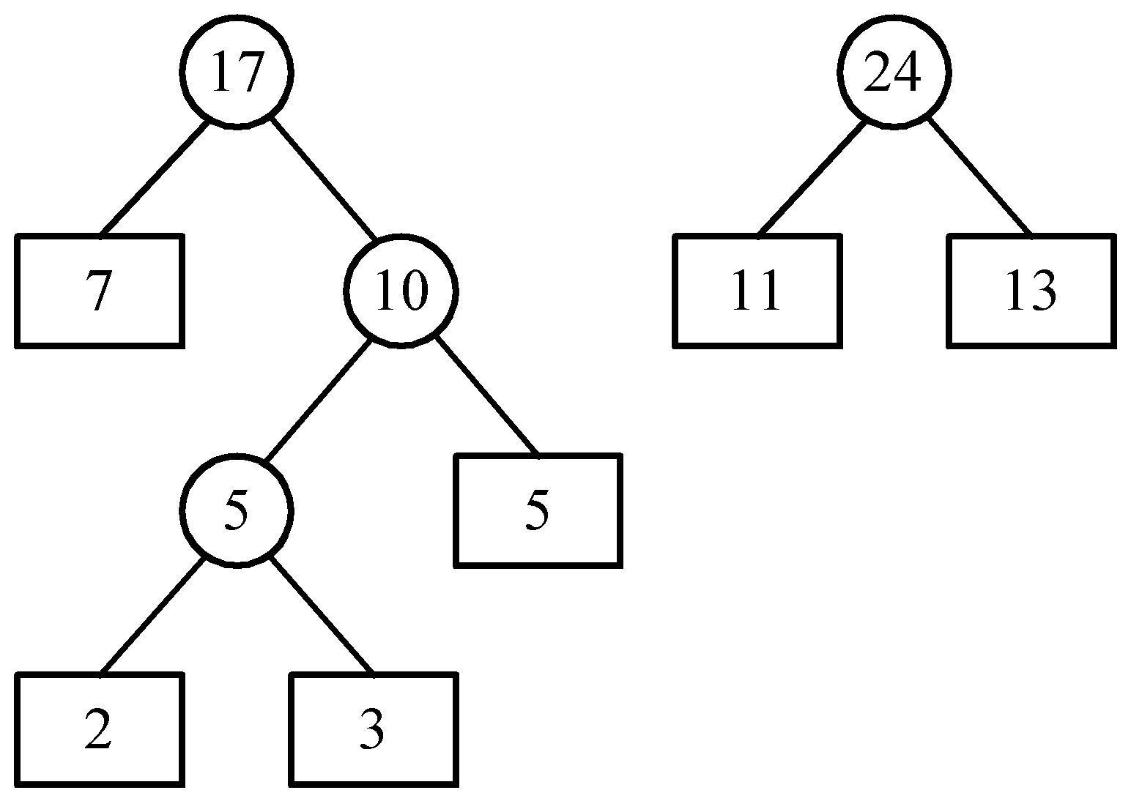
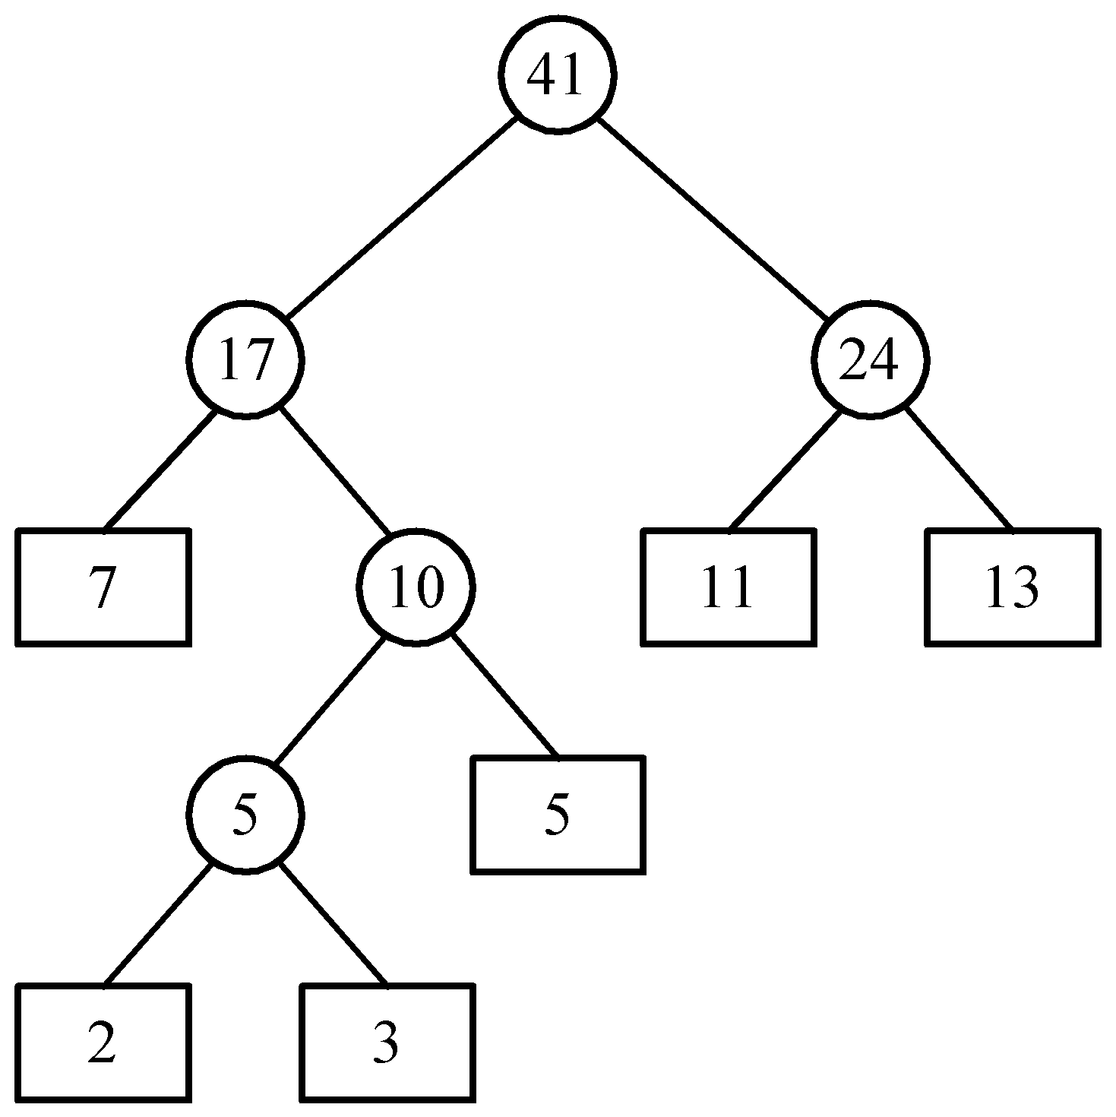
Time complexity for generating an optimal extended binary tree:O(n log n)
4 -<number>

Slide 34
Huffman codes
In telecommunication, how do we represent a set of messages, each with an access frequency, by a sequence of 0’s and 1’s?
To minimize the transmission and decoding costs, we may use short strings to represent more frequently used messages.
This problem can by solved by using an extended binary tree which is used in the 2-way merging problem.
4 -<number>

Slide 35
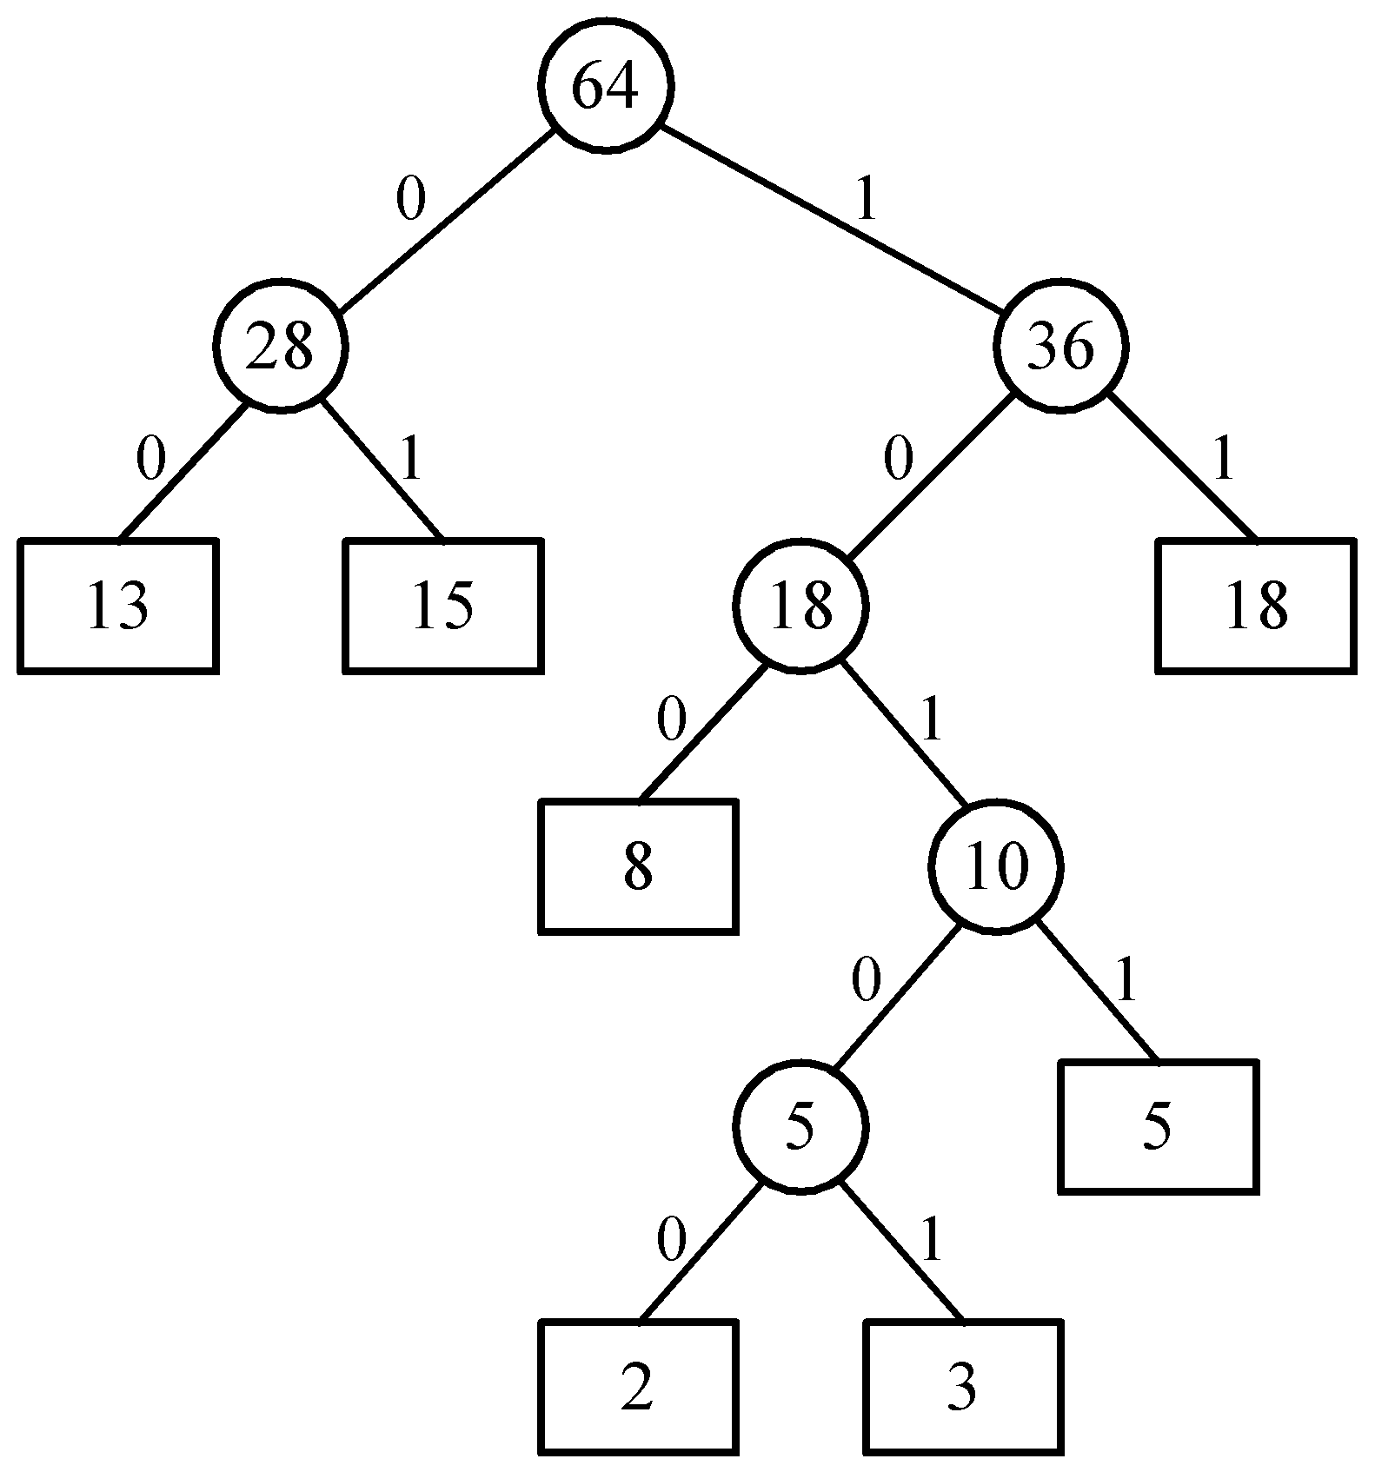
An example of Huffman algorithm
Symbols: A, B, C, D, E, F, G
freq. : 2, 3, 5, 8, 13, 15, 18
Huffman codes:
A: 10100 B: 10101 C: 1011
D: 100 E: 00 F: 01
G: 11
A Huffman code Tree
4 -<number>

Slide 36
Chapter 4 Greedy method
Input(A[1…n])
Solution ←ψ
for i ← 1 to n do
  X ← SELECT(A) (最好有一data structure，經preprocessing後可以很快的找到(包括delete))
  If FEASIBLE( solution, x)
  then solution ← UNION( select, x)
  endif
repeat
Output (solution)
特點
(1)做一串decision
(2)每個decision只關心自己是不是optimal一部份與其它無關 (可以local check)
Note
(1) Local optimal 須是global optimal
(2)有時裡面隱含一個sorting
4 -<number>

Slide 37
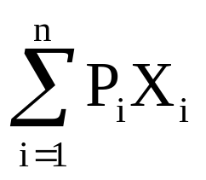
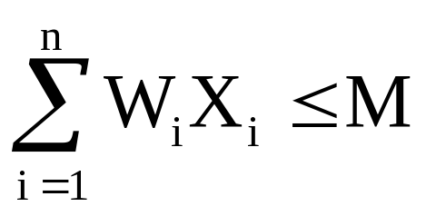
Knapsack problem
Given positive integers P₁, P₂, …, P_{n},
W₁, W₂, …, W_{n} and M.
Find X₁, X₂, … ,X_{n}, 0≦X_{i}≦1 such that
is maximized.
Subject to
4 -<number>

Slide 38
Knapsack Problem Example
M = 20, (P₁, P₂, P₃)=(25,24,15)
(W₁, W₂, W₃) = (18, 15, 10)
Four feasible solutions, 4 is optimal
 | (X₁, X₂, X₃) | ΣW_{i}X_{i} | ΣP_{i}X
1. | (1/2,1/3,1/4) | 16.5 | 24.25
2. | (1,2/15,0) | 20 | 28.2
3. | (0, 2/3, 1) | 20 | 31
4. | (0, 1, 1/2) | 20 | 31.5
4 -<number>

Slide 39

Job Sequencing with Deadlines
Given n jobs. Associated with job I is an integer deadline D_{i}≧0. For any job I the profit P_{i} is earned iff the job is completed by its deadline. To complete a job, one has to process the job on a machine for one unit of time.
A feasible solution is a subset J of jobs such that each job in the subset can be completed by its deadline. We want to maximize the
4 -<number>

Slide 40
n = 4, (p₁, p₂, p₃, p₄) = (100,10,15,27)
(d₁, d₂, d₃, d₄) = (2, 1, 2, 1)
 | Feasible solution | Processing sequence | value
1 | (1,2) | 2,1 | 110
2 | (1,3) | 1,3 or 3, 1 | 115
3 | (1,4) | 4, 1 | 127
4 | (2,3) | 2, 3 | 25
5 | (3,4) | 4,3 | 42
6 | (1) | 1 | 100
7 | (2) | 2 | 10
8 | (3) | 3 | 15
9 | (4) | 4 | 27
4 -<number>

Slide 41
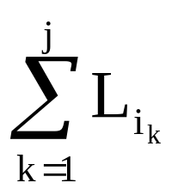
Optimal Storage on Tapes
There are n programs that are to be stored on a computer tape of length L. Associated with each program i is a length L_{i}.
Assume the tape is initially positioned at the front. If the programs are stored in the order I = i₁, i₂, …, i_{n}, the time t_{j} needed to retrieve program i_{j}
t_{j} =
4 -<number>

Slide 42
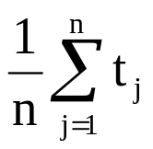
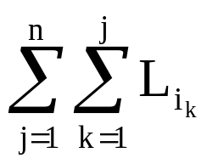
Optimal Storage on Tapes
If all programs are retrieved equally often, then the
mean retrieval time (MRT) =
This problem fits the ordering paradigm. Minimizing the MRT is equivalent to minimizing
d(I) =
4 -<number>

Slide 43
Example
Let n = 3, (L₁,L₂,L₃) = (5,10,3). 6 possible orderings. The optimal is 3,1,2
Ordering I | d(I)
1,2,3 | 5+5+10+5+10+3 = 38
1,3,2 | 5+5+3+5+3+10 = 31
2,1,3 | 10+10+5+10+5+3 = 43
2,3,1 | 10+10+3+10+3+5 = 41
3,1,2 | 3+3+5+3+5+10 = 29
3,2,1, | 3+3+10+3+10+5 = 34
4 -<number>

